Slide 1
Hope &
Hacking:
The XO Story
by Charles Merriam
http://charlesmerriam.com/talk

Slide 2
Notes
Charles Merriam
Cell: 408.368.6050
Email: charles.merriam@gmail.com
Blog: http://charlesmerriam.com/blog
Copy of this talk: http://charlesmerriam.com/talk
Yes, you can have this talk given to your group. Email me.

Slide 3
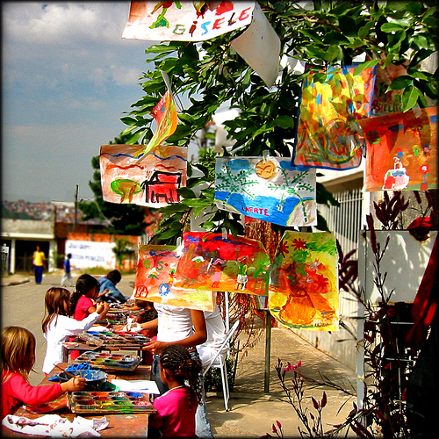

Slide 4
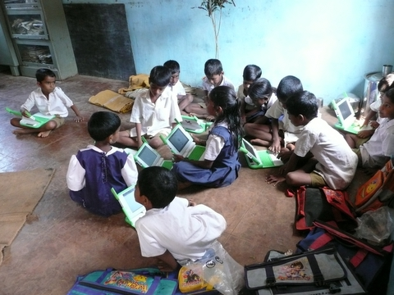

Slide 5


More Stuff
Best Deployment Story
  http://wiki.laptop.org/go/OLPC_Peru/Arahuay
  See what happens when you give laptops to children in the isolated agricultural town of Arahuay, Peru.
Best Video Overview
  http://www.ted.com/index.php/talks/view/id/41
  Nicholas Negroponte talks at the TED talks in February, 2006.

Slide 6
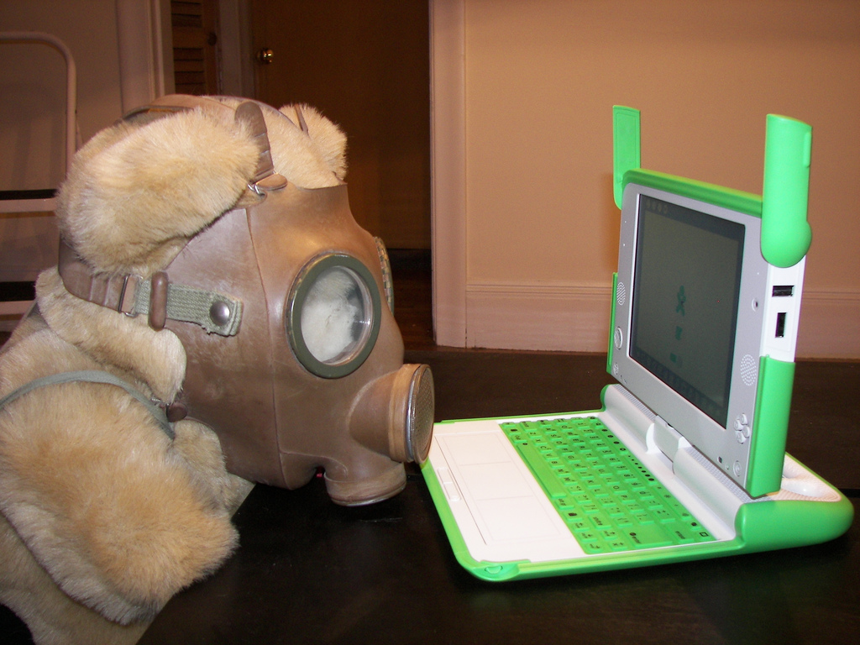

Slide 7
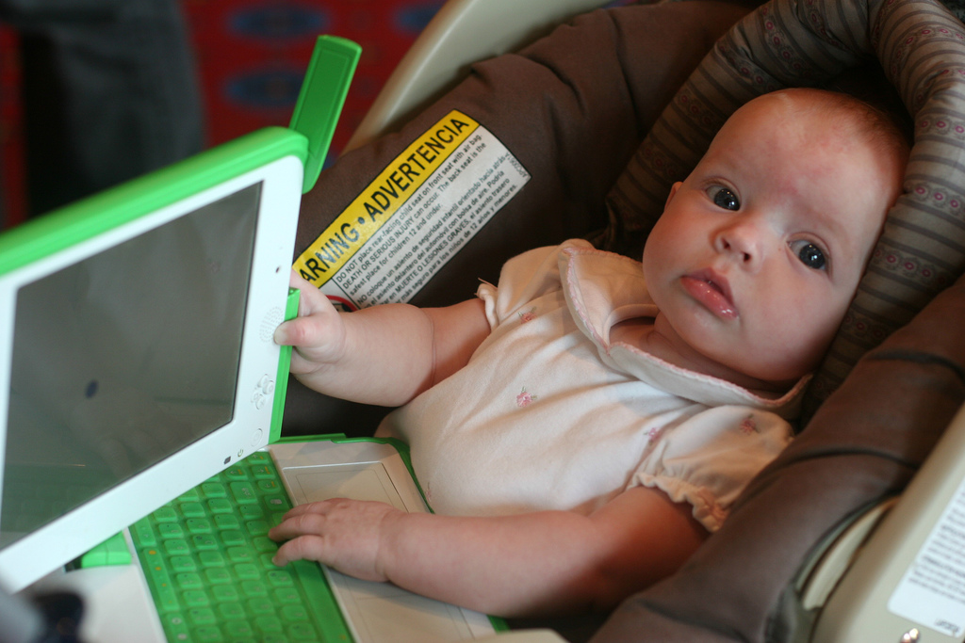

Slide 8
getting comfortable
Play with it. Make a spiro-graph in TurtleArt, run the EToys tutorials, browse, read a PDF.
Set up a mesh. Chat. Measure things. Edit the same document. Edit the same video. Jam.
Read “Getting Started”, “Cheat Keys”, and “Keyboard Short-cuts”
Flash the firmware. Upgrade the OS. Get a developer's key. Hang out on #olpc.

Slide 9
Best Starting Point for Using the OLPC
  http://www.laptop.org/en/laptop/start/
Best L33T Factbytes
  http://wiki.laptop.org/go/Cheat_codes
  http://wiki.laptop.org/go/Keyboard_Shortcuts
  http://wiki.laptop.org/go/Upgrading_the_firmware
  http://wiki.laptop.org/go/Olpc-update
Best Chat Room to Lurk
  irc://freenode/olpc

Slide 10
developing Python code
Develop directly on the XO.
May build emulators, images, and virtual machines. Was very important when few XOs.
Get a USB keyboard and mouse. Sharing your X display is slow. Update your editor.
Fair amount of cut-and-paste. All source is on-line.

Slide 11
Best Overview of Developing Applications
  http://wiki.laptop.org/go/Hacking_Sugar
Best Source Code
  http://dev.laptop.org/git
X
  http://wiki.laptop.org/go/Remote_display

Slide 12
developing an “Activity”
Requires standard parts and file names: a logo (.svg), info file (text), a few others, and then your code.
Your application inherits from activity, and implements the _init__() routine.
Usually write with PyGtk, Pango, GStreamer, PyGame, D-Bus, Telepathy and the rest.

Slide 13
Best XO Buzzword Definitions
  http://wiki.laptop.org/go/Developers/Stack
Best Walkthrough Recipe
  http://wiki.laptop.org/go/Sugar_Activity_Tutorial
Best Walkthrough Mesh Recipe
  http://wiki.laptop.org/go/Tubes_Tutorial

Slide 14
from sugar.activity import activity
import logging
import sys, os
import gtk
class HelloWorldActivity(activity.Activity):
def hello(self, widget, data=None):
logging.info('Hello World')

Slide 15
def __init__(self, handle):
print "running activity init", handle
activity.Activity.__init__(self, handle)
print "activity running"
# Toolbox contains Toolbar, e.g., 'Collaborate' and 'Close' buttons.
toolbox = activity.ActivityToolbox(self)
self.set_toolbox(toolbox)
toolbox.show()
self.button = gtk.Button("Hello World")
self.button.connect("clicked", self.hello, None)
self.set_canvas(self.button)
self.button.show()

Slide 16
Thank you

Slide 17
photo credits
    http://flickr.com/photos/beija-flor/55999896/
    http://wiki.laptop.org/go/Image:India.JPG
    http://flickr.com/photos/pixelfish/2128182241/
    http://flickr.com/photos/marksurman/896015862/

